Slide 1
Utopia and Dystopia
Turn to the “Notes” Section of your binder/notebook.

Slide 2
Utopia
Definition
A place, state, or condition that is ideally perfect in respect of politics, laws, customs, and conditions.
•Citizens have no fear of the outside world.
•Citizens live in a harmonious state.
•The natural world is embraced and revered.
•Citizens embrace social and moral ideals. Individuality and innovation are welcomed.
•The society evolves with change to make a perfect utopian world.
Characteristics
•Information, independent thought, and freedom are promoted.
•A figurehead or concept brings the citizens of the society together, but not treated as singular.
•Citizens are truly free to think independently.

Slide 3
Utopian Ideas
Most utopian works present a world in which societal ideals and the common good of society are maintained through one or more of the following types of beliefs:
Economic ideas:
Money is abolished. Citizens only do work that they enjoy.
Governing ideas:
Society is controlled by citizenry in a largely individualist, communal, social and sometimes libertarian “government.”
The term “government” is used loosely, as power is seen to corrupt, so constructed government systems are warned against.

Slide 4
Utopian Ideas cont’d
Technological ideas:
Technology may be embraced to enhance the human living experience and make human life easier and more convenient.
Other ideas propose that technology drives a wedge between humanity and nature, therefore becoming an evil to society.
Ecological ideas:
Back to Nature
Humans live harmoniously with nature and reverse the effects of industrialization.
Philosophical/religious ideas:
Society believes in a common religious philosophy, some fashion their surroundings around the biblical Garden of Eden.
In inter-religious utopias, all ideas of God are welcomed.
In intra-religious utopias, a singular idea of God is accepted and practiced by all citizens.

Slide 5
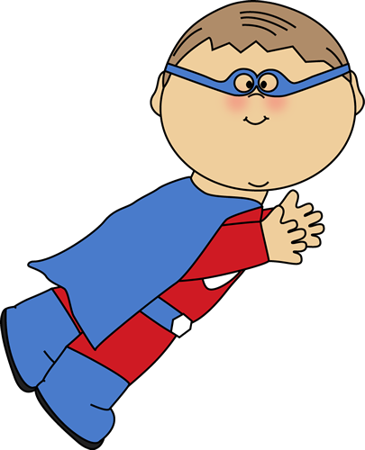
The Utopian Protagonist
Works to promote the ideals of society
Questions the existing social and political systems with the aim to bring positive change
Believes or feels that the society in which he or she lives is always getting better
Helps the audience recognize the positive aspects of the utopian world through his or her perspective

Slide 6
Dystopia – Definition
A futuristic, imagined universe in which oppressive societal control and the illusion of a perfect society are maintained through corporate, bureaucratic, technological, moral, or totalitarian control.
Dystopias, through an exaggerated worst-case scenario, make a criticism about a current trend, societal norm, or political system.

Slide 7
Dystopia
Characteristics of a Dystopian Society:
Propaganda is used to control the citizens of society.
Information, independent thought, and freedom are restricted.
A figurehead or concept is worshipped by the citizens of the society.
Citizens are perceived to be under constant surveillance.
Citizens have a fear of the outside world.
Citizens live in a dehumanized state.
The natural world is banished and distrusted.
Citizens conform to uniform expectations. Individuality and dissent are bad.
The society is an illusion of a perfect utopian world.

Slide 8
Types of Dystopian Controls
Most dystopian works present a world in which oppressive societal control and the illusion of a perfect society are maintained through one or more of the following types of controls:
Corporate control: One or more large corporations control society through products, advertising, and/or the media. Examples include Minority Report and Running Man.
Bureaucratic control: Society is controlled by a mindless bureaucracy through a tangle of red tape, relentless regulations, and incompetent government officials. Examples in film include Brazil.
Technological control: Society is controlled by technology—through computers, robots, and/or scientific means. Examples include The Matrix, The Terminator, and I, Robot.
Philosophical/religious control: Society is controlled by philosophical or religious ideology often enforced through a dictatorship or theocratic government.

Slide 9
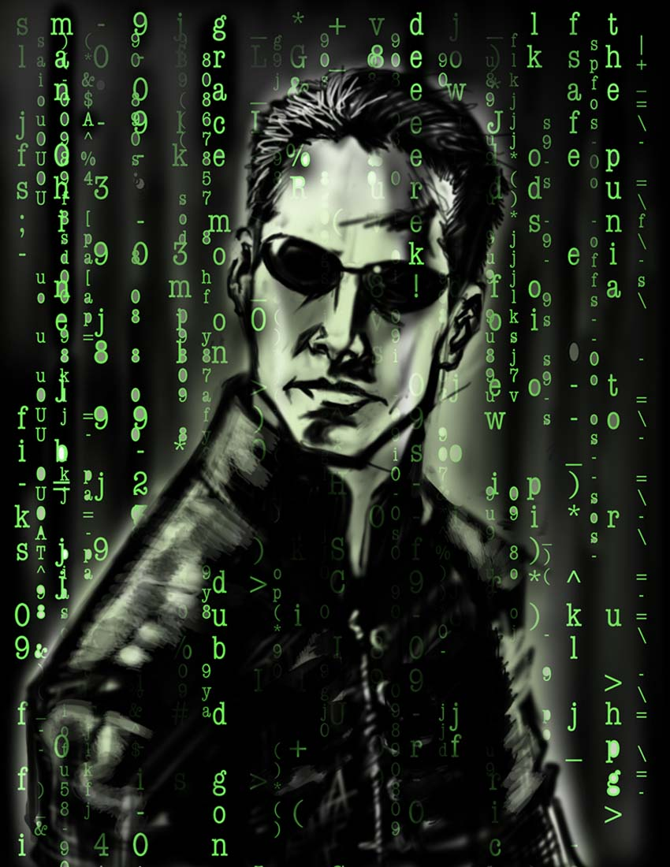
The Dystopian Protagonist
Often feels trapped and is struggling to escape
Questions the existing social and political systems
Believes or feels that something is terribly wrong with the society in which he or she lives
Helps the audience recognizes the negative aspects of the dystopian world through his or her perspective

